Slide 1
17.4 Rule-Based Expert Systems (1/9)
Expert Systems
  One of the most successful applications of AI reasoning technique using facts and rules
  “AI Programs that achieve expert-level competence in solving problems by bringing to bear a body of knowledge [Feigenbaum, McCorduck & Nii 1988]”
Expert systems vs. knowledge-based systems
Rule-based expert systems
  Often based on reasoning with propositional logic Horn clauses.

Slide 2
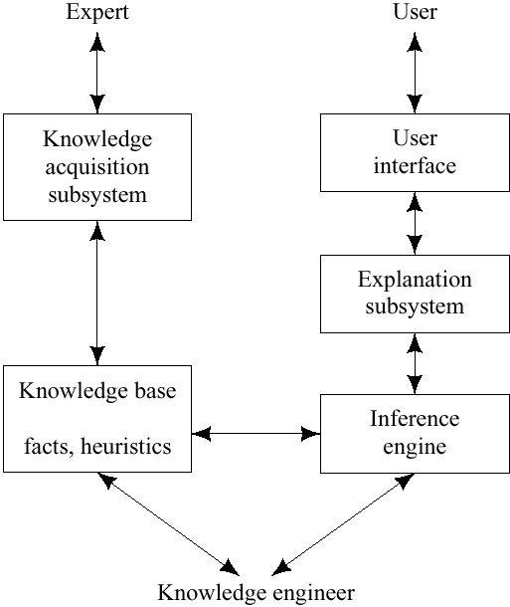
17.4 Rule-Based Expert Systems (2/9)
Structure of Expert Systems
  Knowledge Base
    Consists of predicate-calculus facts and rules about subject at hand.
  Inference Engine
    Consists of all the processes that manipulate the knowledge base to deduce information requested by the user.
  Explanation subsystem
    Analyzes the structure of the reasoning performed by the system and explains it to the user.

Slide 3
17.4 Rule-Based Expert Systems (3/9)
Knowledge acquisition subsystem
  Checks the growing knowledge base for possible inconsistencies and incomplete information.
User interface
  Consists of some kind of natural language processing system or graphical user interfaces with menus.
“Knowledge engineer”
  Usually a computer scientist with AI training.
  Works with an expert in the field of application in order to represent the relevant knowledge of the expert in a forms of that can be entered into the knowledge base.

Slide 4
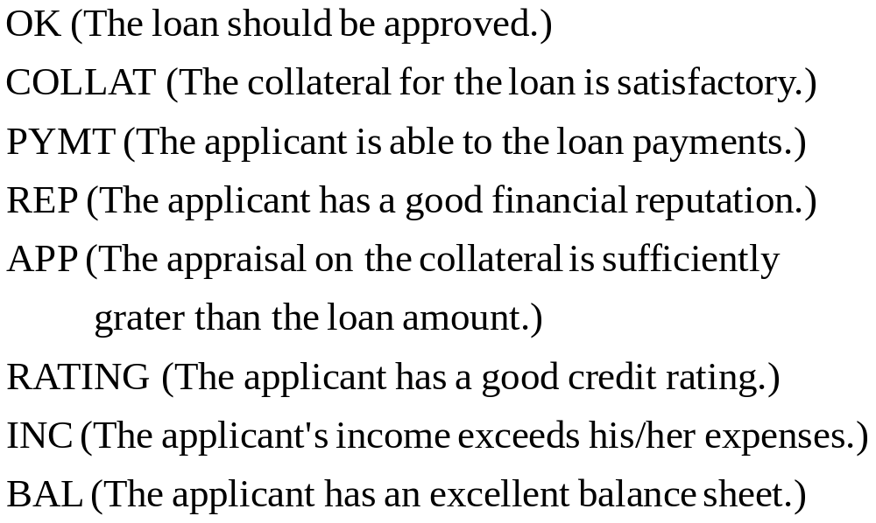
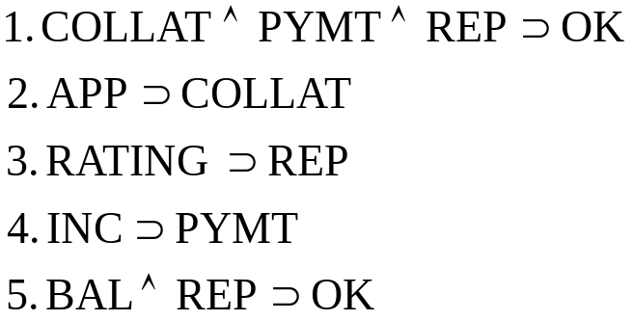
17.4 Rule-Based Expert Systems (4/9)
Example: loan officer in a bank
“Decide whether or not to grant a personal loan to an individual.”
Facts
Rules

Slide 5
17.4 Rule-Based Expert Systems (5/9)
To prove OK
  The inference engine searches fro AND/OR proof tree using either backward or forward chaining.
AND/OR proof tree
  Root node: OK
  Leaf node: facts
  The root and leaves will be connected through the rules.
Using the preceding rule in a backward-chaining
  The user’s goal, to establish OK, can be done either by proving both BAL and REP or by proving each of COLLAT, PYMT, and REP.
  Applying the other rules, as shown, results in other sets of nodes to be proved.

Slide 6
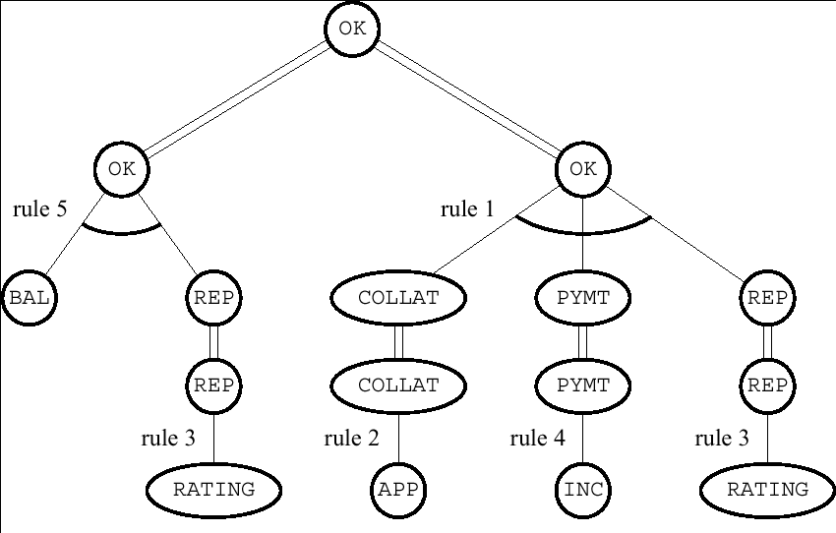
17.4 Rule-Based Expert Systems (6/9)
By backward-chaining

Slide 7
17.4 Rule-Based Expert Systems (7/9)
Consulting system
  Attempt to answer a user’s query by asking questions about the truth of propositions that they might know about.
  Backward-chaining through the rule is used to get to askable questions.
  If a user were to “volunteer” information, bottom-up, forward chaining through the rules could be used in an attempt to connect to the proof tree already built.
  The ability to give explanations for a conclusion
    Very important for acceptance of expert system advice.
  Proof tree
    Used to guide the explanation-generation process.

Slide 8
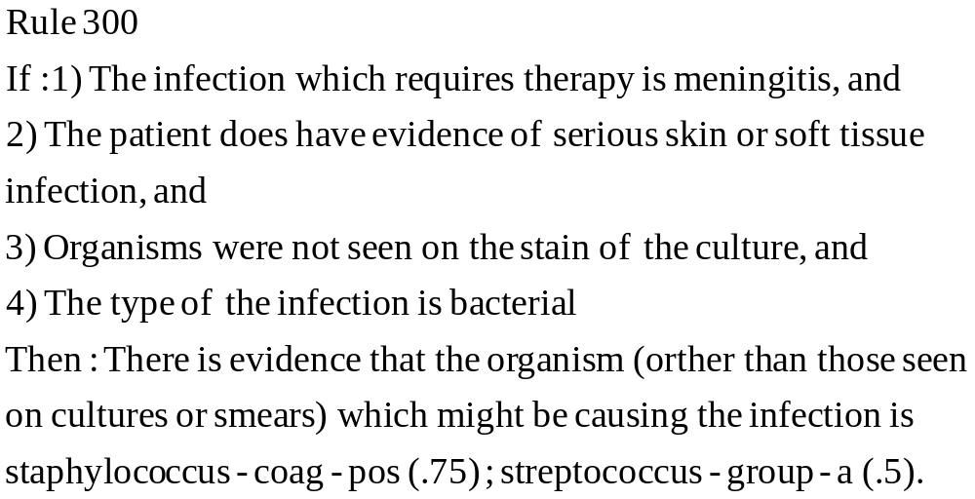
17.4 Rule-Based Expert Systems (8/9)
In many applications, the system has access only to uncertain rules, and the user not be able to answer questions with certainty.
MYCIN [Shortliffe 1976]: Diagnose bacterial infections.

Slide 9
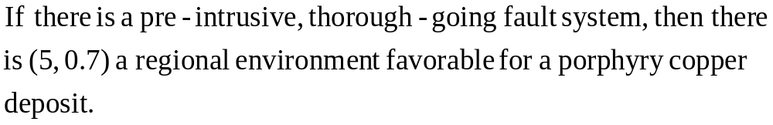
17.4 Rule-Based Expert Systems (9/9)
  PROSPECTOR [Duda, Gaschnig & Hart 1979, Campbell, et al. 1982]
    Reason about ore deposits.
  The numbers (.75 and .5 in MYCIN, and 5, 0.7 in PROSPECTOR) are ways to represent the certainty or strength of a rule.
  The numbers are used by these systems in computing the certainty of conclusions.

Slide 10
17.5 Rule Learning
Inductive rule learning
  Creates new rules about a domain, not derivable from any previous rules.
  Ex) Neural networks
Deductive rule learning
  Enhances the efficiency of a system’s performance by deducting additional rules from previously known domain rules and facts.
  Ex) EBG (explanation-based generalization)

Slide 11

17.5.1 Learning Propositional Calculus Rules (1/9)
Train rules from given training set
  Seek a set of rules that covers only positive instances
    Positive instance: OK = 1
    Negative instance: OK = 0
  From training set, we desire to induce rules of the form
  We can make some rule more specific by adding an atom to its antecedent to make it cover fewer instances.
    Cover: If the antecedent of a rule has value True for an instance in the training set, we say that the rule covers that instance.
  Adding a rule makes the system using these rules more general.
  Searching for a set of rules can be computationally difficult.
    ➔here, we use “greedy” method which is called separate and conquer.

Slide 12
17.5.1 Learning Propositional Calculus Rules (2/9)
Separate and conquer
  First attempt to find a single rule that covers only positive instances
    Start with a rule that covers all instances
    Gradually make it more specific by adding atoms to its antecedent.
  Gradually add rules until the entire set of rules covers all and only the positive instances.
  Trained rules can be simplified using pruning.
    Operations and noise-tolerant modifications help minimize the risk of overfitting.

Slide 13



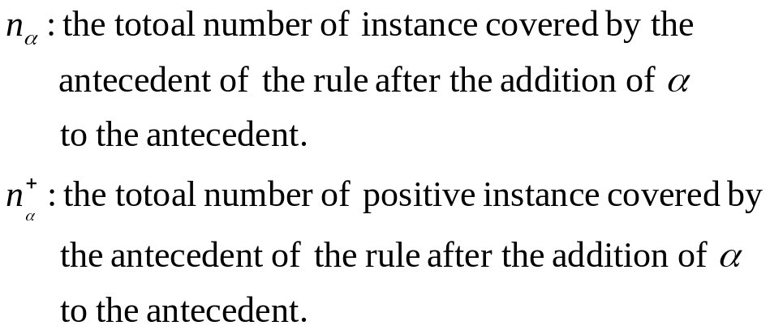
17.5.1 Learning Propositional Calculus Rules (3/9)
Example: loan officer in a bank
  Start with the provisional rule .
    Which cover all instances.
  Add an atom it cover fewer negative instances-working toward covering only positive ones.
  Decide, which item should we added ?
    From by

Slide 14


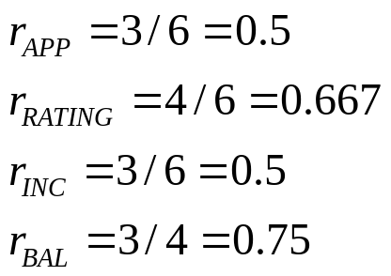

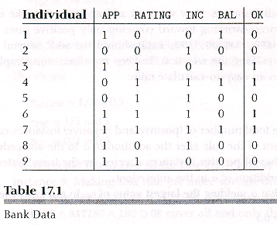
17.5.1 Learning Propositional Calculus Rules (4/9)
Select that yielding the largest value of .
So, we select BAL, yielding the provisional rule.

Slide 15
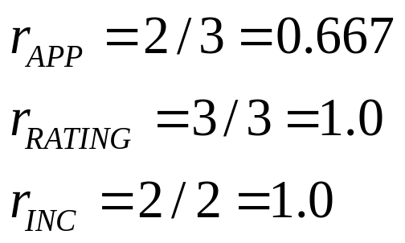


17.5.1 Learning Propositional Calculus Rules (5/9)
Rule covers the positive instances 3,4, and 7, but also covers the negative instance 1.
  So, select another atom to make this rule more specific.
We have already decided that the first component in the antecedent is BAL, so we have to consider it.
We select RATING because is based on a larger sample.

Slide 16
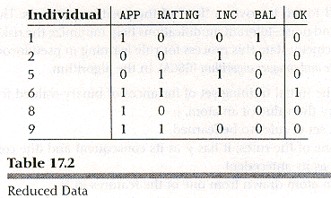
17.5.1 Learning Propositional Calculus Rules (6/9)
  We need more rules which cover positive instance 6. To learn the next rule, eliminate from the table all of the positive instances already covered by the first rule.

Slide 17
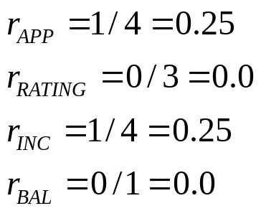

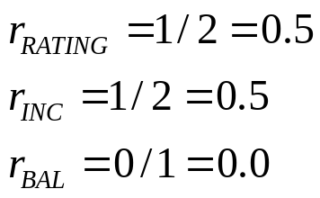

17.5.1 Learning Propositional Calculus Rules (7/9)
Begin the process all over again with reduced table
  Start with the rule .
  Finally we get which covers only positive instances with first rule, so we are finished.
APP=INC=0.25, arbitrarily select APP.
This rule covers negative instances 1, 8, and 9 ➔ we need another atom to the antecedent.
Select RATING, and we get
This rule covers negative example 9.

Slide 18
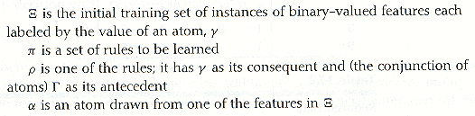
17.5.1 Learning Propositional Calculus Rules (8/9)
Pseudocode of this rule learning process.
  Generic Separate-and-conquer algorithm (GSCA)

Slide 19
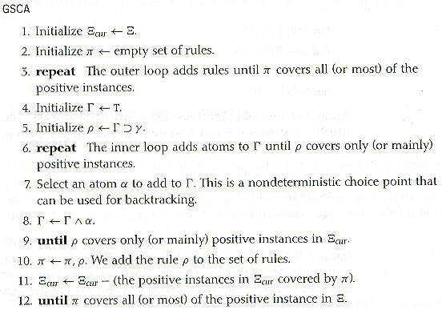
17.5.1 Learning Propositional Calculus Rules (9/9)

Slide 20






17.5.2 Learning First-Order Logic Rules (1/10)
Inductive logic programming (ILP)
  Concentrate on methods for inductive learning of Horn clauses in first order predicate calculus (FOPC) and thus PROLOG program.
  FOIL [Quinlan, 1990]
The Objective of ILP
  To learn a program, ,consisting of Horn clauses, ,each of which is of the form where, the are atomic formulas that unify with ground atomic facts.
    : should evaluate to True when its variables are bound to some set of values known to be in the relation we are trying to learn (positive instance: training set).
    : should evaluate to False when its variables are bound to some set of values known not to be in the relation (negative instance).

Slide 21

17.5.2 Learning First-Order Logic Rules (2/10)
We want to cover the positives instances and not cover negative ones.
Background knowledge
  The ground atomic facts with which the are to unify.
  They are given-as either subsidiary PROLOG programs, which can be run and evaluated, or explicitly in the form of a list of facts.
Example: A delivery robot navigating around in a building finds through experience, that it is easy to go between certain pairs of locations and not so easy to go between certain other pairs.

Slide 22
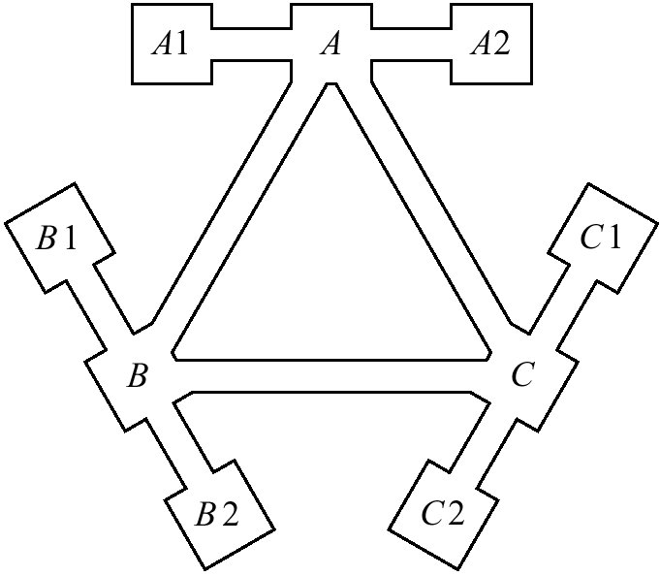
17.5.2 Learning First-Order Logic Rules (3/10)
A, B, C: junctions
All of the other locations: shops
Junction(x)
  Whether junction or not.
Shop(x,y)
  Whether shop or not which is connected to junction x.

Slide 23

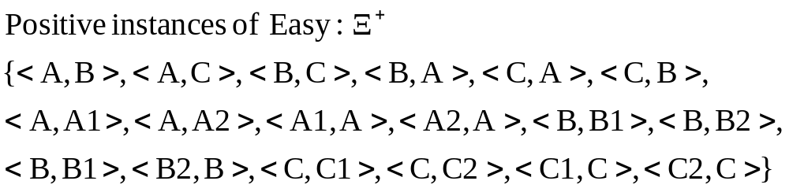
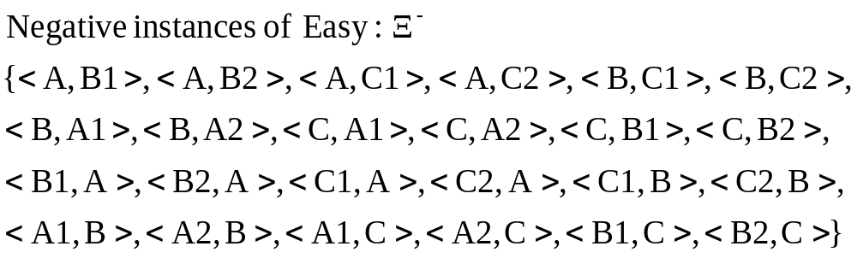
17.5.2 Learning First-Order Logic Rules (4/10)
We want a learning program to learn a program, Easy(x,y) that covers the positive instances in but not the negative ones.
Easy(x,y) can use the background subexpressions Junction(x) and Shop(x,y).
Training set

Slide 24
17.5.2 Learning First-Order Logic Rules (5/10)
  For all of the locations named in , only the following pairs give a value True for Shop:
  The following PROLOG program covers all of the positive instances of the training set and none of the negative ones
    Easy(x, y) :- Junction(x), Junction(y)
    :- Shop(x, y)
    :- Shop(y, x)

Slide 25
17.5.2 Learning First-Order Logic Rules (6/10)
Learning process: generalized separate and conquer algorithm (GSCA)
  Start with a program having a single rule with no body
  Add literals to the body until the rule covers only (or mainly) positive instances
  Add rules in the same way until the program covers all (or most) and only (with few exceptions) positive instances.

Slide 26
17.5.2 Learning First-Order Logic Rules (7/10)
  Practical ILP systems restrict the literals in various ways.
  Typical allowed additions are
    Literals used in the background knowledge
    Literals whose arguments are a subset of those in the head of the clause.
    Literals that introduce a new distinct variable different from those in the head of the clause.
    A literal that equates a variable in the head of the clause with another such variable or with a term mentioned in the background knowledge.
    A literal that is the same (except for its arguments) as that in the head of the clause.

Slide 27
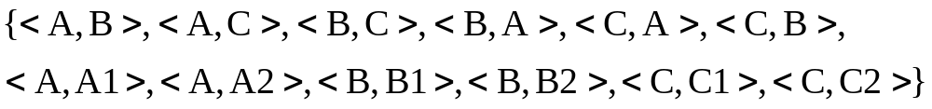
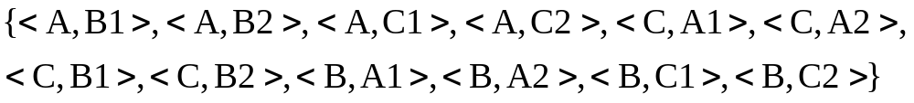
17.5.2 Learning First-Order Logic Rules (8/10)
The literals that we might consider adding to a clause are
ILP version of GSCA
  First, initialize first clause as Easy(x, y) :-
  Add Junction(x), so Easy(x, y) :- Junction(x) covers the following instances
  Include more literal ‘Junction(y)’ ➔ Easy(x, y) :- Junction(x), Junction(y)
Junction(x), Junction(y), Junction(z)
Shop(x,y), Shop(y,x), Shop(x,z)
Shop(z,y), (x=y)
Positive instances
Negative instances

Slide 28
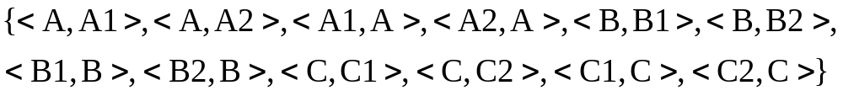


17.5.2 Learning First-Order Logic Rules (9/10)
  But program does not cover the following positive instances.
  Remove the positive instance covered by Easy(x,y):-Junction(x), Junction(y) from to form the to be used in next pass through inner loop.
    : all negative instance in + the positive instance that are not covered yet.
  Inner loop create another initial clause “Easy(x,y) :-”
    Add literal Shop(x,y) : Easy(x,y) :- Shop(x,y) ➔ cover no negative instances, so we are finished with another pass through inner loop.
    Covered positive instance by this rule ( remove this from )

Slide 29
17.5.2 Learning First-Order Logic Rules (10/10)
  Now we have Easy(x,y) :- Junction(x), Junction(y) :- Shop(x, y)
  To cover following instance
  Add Shop(y, x)
  Then we have Easy(x,y) :- Junction(x), Junction(y) :- Shop(x, y) :- Shop(y, x)
  This cover only positive instances.

Slide 30
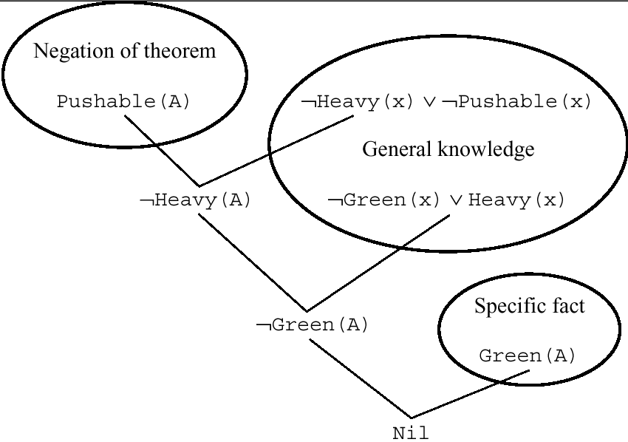



17.5.3 Explanation-Based Generalization (1/2)
Example: “Block world”
  General knowledge of the “Block world”.
    Rules
    Fact
    We want to proof
    “ ”
    Proof is very simple ➔

Slide 31



17.5.3 Explanation-Based Generalization (2/2)
Explanation: Set of facts used in the proof
  Ex) explanation for “ ” is “ ”
  From this explanation, we can make “ ”
    Replacing constant ‘A’ by variable ‘x’, then, we have “Green(x)”
    Then we can proof “ ”, as like the case of “ ”
    ➔Explanation Based Generalization
Explanation-based generalization (EBG): Generalizing the explanation by replacing constant by variable
  More rules might slow down the reasoning process, so EBG must be used with care-possibly by keeping information about the utility of the learned rules.

Slide 32
Additional Readings (1/4)
[Levesque & Brachman 1987]
  Balance between logical expression and logical inference
[Ullman 1989]
  DATALOG
[Selman & Kautz 1991]
  Approximate theory: Horn greatest-lower-bound, Horn least-upper-bound
[Kautz, Kearns, & Selman 1993]
  Characteristic model

Slide 33
Additional Readings (2/4)
[Roussel 1975, Colmerauer 1973]
  PROLOG interpreter
[Warren, Pereira, & Pereira 1977]
  Development of efficient interpreter
[Davis 1980]
  AO* algorithm searching AND/OR graphs
[Selman & Levesque 1990]
  Determination of minimum ATMS label: NP-complete problem

Slide 34
Additional Readings (3/4)
[Kautz, Kearns & Selman 1993]
  TMS calculation based on characteristic model
[Doyle 1979, de Kleer 1986a, de Kleer 1986b, de Kleer 1986c, Forbus & de Kleer 1993, Shoham 1994]
  Other results for TMS
[Bobrow, Mittal & Stefik 1986], [Stefik 1995]
  Construction of expert system

Slide 35
Additional Readings (4/4)
[McDermott 19982]
  Examples of expert systems
[Leonard-Barton 1987]
  History and usage of DEC’s expert system
[Kautz & Selman 1992], [Muggleton & Buntine 1988]
  Predicate finding
[Muggleton, King & Sternberg 1992]
  Protein secondary structure prediction by GOLEM

